Slide 1


U20CSPR01- MINIPROJECT : SECOND REVIEW
BATCH NO: A17
DOMAIN: WEB DEVELOPMENT
PROJECT TITLE : Enhance to develop the application for the Hotel Booking Services.
S. No. | Register number | Name of the Student
1 | U21CN024 | NADIPI BAYYA REDDY
2 | U21CN038 | NARAVULA MEGHENDRA
3 | U21CN032 | NAKKA YASWANTH
4 | U21CN003 | MOTHUKURI VENKATA SAI
GUIDED BY: MS.R.SHAMLI

Slide 2
CONTENTS
Abstract
Problem Statement
Objective
Introduction
Existing System
Proposed System
Literature Survey
System Architecture
Modules
Implementation
Results and Discussions
Conclusion and Future Scope
References

Slide 3

Abstract
The provided Flask-based web application is a comprehensive hotel management system integrating multiple functionalities to streamline operations for both administrators and users. This application leverages MySQL for database management and focuses on modules like user authentication, room management, restaurant menu handling, booking, order processing, and customer reviews. Administrators can log in through a secure portal to manage rooms, edit or delete room details, oversee restaurant menus, and handle orders. The room management system supports CRUD operations, ensuring seamless addition, updating, and availability tracking of rooms. The platform supports features such as multi-room booking, real-time availability checks, and payment integration, providing users with a seamless booking experience.

Slide 4
Problem Statement
In the hospitality industry, efficient management of reservations and customer data is crucial for providing an excellent guest experience.
Issues like human errors, delays, and poor data accessibility in traditional systems.
Difficulty in combining room booking, restaurant management, and customer feedback in a unified platform.
By automating routine tasks and centralizing data, a hotel booking management system helps reduce human error, improve customer satisfaction, and increase overall operational efficiency.
Risks of unauthorized access and data breaches in online systems.

Slide 5
Objective
ØStreamline Booking Processes
ØImprove Room Inventory Management
ØEnhance Guest Experience
ØImprove Check-In and Check-Out Experience
ØIncrease Operational Efficiency

Slide 6
Introduction
In today's fast-paced world, the convenience of online hotel booking services has transformed the way travelers plan their accommodations.
This project aims to develop a user-friendly platform that streamlines the hotel booking process, making it accessible for everyone from casual travelers to business professionals.
With a myriad of options available, choosing the right hotel can be overwhelming. Our service will allow users to efficiently search and compare hotels based on their preferences, including location, price, and amenities.
By providing detailed listings and user reviews, we empower customers to make informed decisions.

Slide 7
Existing System
User Registration
Room Availability
Booking Process
Payment Process
Reviews and Ratings
Restaurant Availability

Slide 8
Proposed System
Enhanced User Experience
Price Comparison
Improved Booking Flexibility
Web Application

Slide 9
Literature Survey
S.No | Paper Title ,Author Name & Year | Journal Name | Techniques Used | Observations
1 | Web Based Hotel Management System (November 2022) | Dukare Siddhesh Sudam Bhalerao Akanksha Santosh | Azure Boards , GitHub , SonarQube , Selenium | The literature review we consider and examine the work done by researchers who have broached on this particular topic (Hotel Management System). As mentioned above, the main purpose of hotel industry is to offer consumers’ hospitality services. Technology has a considerable impact on Hospitality industry in previous years and will continue to do so with the increasing use of computer Technology, controlled equipment” (Jones and Lockwood, 1989,) .

Slide 10
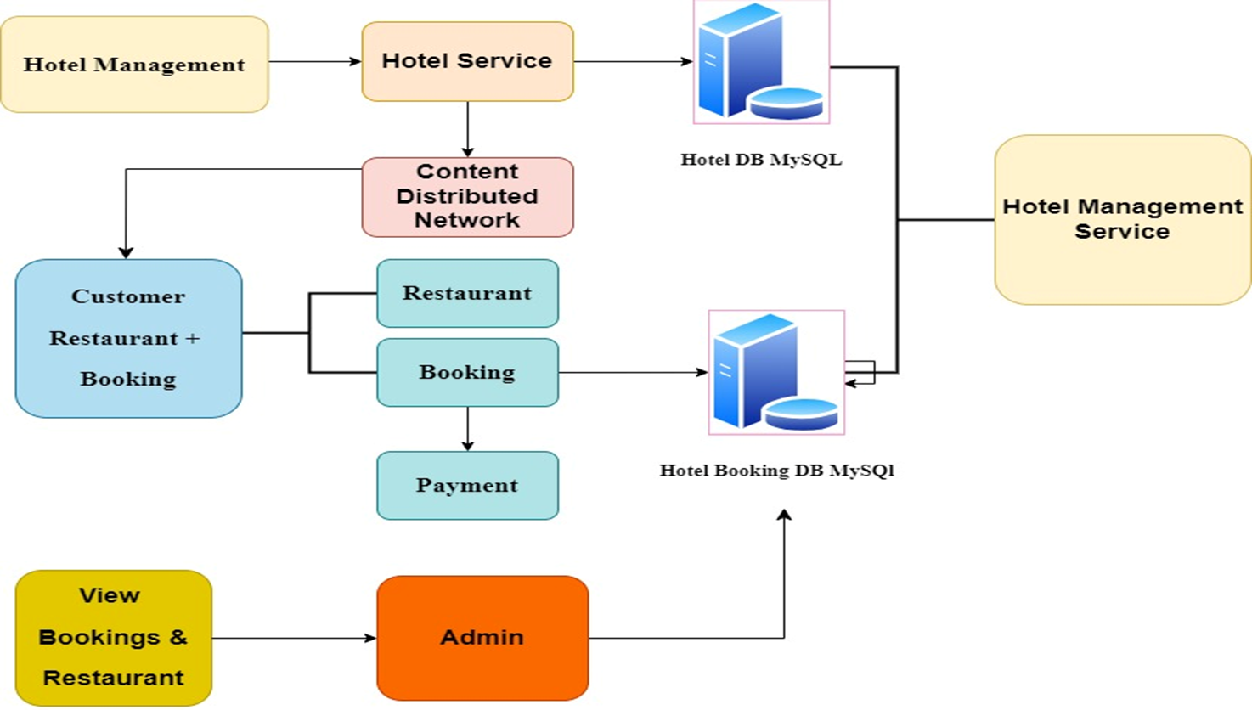
System Architecture

Slide 11
Modules
User Authorization Module
Booking Management Module
Payment Processing Module
Admin Panel Module
Restaurant Management Module
Reviews and Ratings Module

Slide 12
Implementation
Implementing a Hotel Booking Services System involves multiple stages, from initial planning to development, testing, deployment, and maintenance. Here’s a step-by-step breakdown of the implementation process:
Requirements Gathering and Analysis
System Design and Architecture
Frontend Development (HTML/CSS)
Backend Development (PYTHON FLASK)
Database Setup (MySQL DATABSE)

Slide 13
Results and Discussions
After the successful implementation of the Hotel Booking Management System, various key performance metrics and functional outcomes can be assessed.
The system enables users to seamlessly search for hotels, check room availability, and make bookings with a few clicks, reducing manual intervention by hotel staff.
The results can be categorized into operational efficiency, user satisfaction, and overall system performance.

Slide 14
Conclusion and Future Scope
The Hotel Booking Services system provides a comprehensive platform for managing hotel reservations, offering users an intuitive interface for searching, booking, and managing their stays.
By integrating key features like availability, secure payments, and personalized user experiences, the system streamlines the booking process, ensuring a seamless experience for both customers and hotel administrators. the potential to become a central hub for both users and hoteliers, enhancing the customer experience through smart technologies while optimizing hotel operations.
Future developments in AI, blockchain, AR/VR, and sustainability can elevate the system further, keeping pace with technological trends and the growing demand for more personalized, secure, and eco-friendly travel solutions.
By continuously adapting to market needs, the system can solidify its position as an industry leader in the evolving hospitality and travel landscape.

Slide 15
References
J. Wu. (2010). A study of the hotel industry's application of the web site as a marketing tool. 3rd International Conference on Information Management, Innovation Management and Industrial Engineering, pp. 632-635. DOI: 10.1109/ICIII.2010.471.
A. Pathak, A. Singhal & B. K. Rana. (2021). Review on hotel management system. 3rd International Conference on Advances in Computing, Communication Control and Networking (ICAC3N), pp. 1834-1837. DOI: 10.1109/ICAC3N53548.2021.9725658.
Gray, W. S. & S. C. Liguori. (2002). Hotel and motel management and operations.
K. Tsujii, K. Tsuda & M. Takahashi. (2015). Towards extracting the hotel evaluations from the comments by the foreign tourists with text mining. 4th International Congress on Advanced Applied Informatics, pp. 46-49. DOI: 10.1109/IIAI-AAI.2015.
Gretzel, Ulrike & Kyung Hyan Yoo. (2008). Use and impact of online travel reviews. Information and Communication Technologies in Tourism 2008, pp. 35-46.

